Slide 1
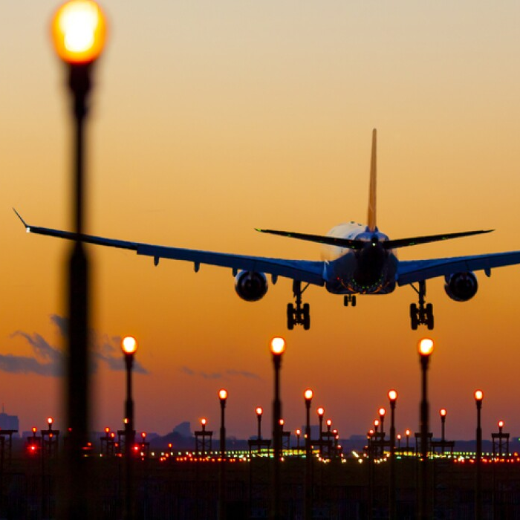
SENTIMENTAL ANALYSIS ON TOP TEN AIRLINES
Capstone Project (DAB-402)
Presented By:
Priya (0779602)
Presented To:
Savita Seharawat

Slide 2
Main Objective
Why
I want to explore some concept of sentiment analysis, so I fetched top ten Airlines tweets from Twitter.
Text Preprocessing
Remove the noise from tweets using NLP(Natural Language Processing)
Sentiments
To get sentiments either the airline service has positive, negative or neutral response.
Machine Learning Models
Will try some libraries that can help in data analysis and sentiment analysis. Try different classification methods to find highest accuracy.

Slide 3
Introduce Dataset
Dataset: A sentiment analysis project on ten major airlines (such as Air Canada, Emirates, Qatar Airways, Singapore Airlines, Turkish Airlines, British Airways, Lufthansa, United Airlines, Air France, Air Asia)
The Sentiment analysis in the airline business can assist customers in deciding which airline is best by studying other customer opinions from Twitter comments. Public opinion has been used in this way in a variety of situations. Airline industry is the growing billion-dollar industry and it also have millions of passengers. Sentiment analysis on Airlines is also taken. Regarding the airline industry, sentiment analysis has the potential to help customers decide which airline is best by analyzing other customer opinions. It is based on the classification of twitter data into positive, negative, and neutral command.
Keywords: NLP (Natural Language Processing) and models such as Logistic Regression, K-nearest neighbor (KNN), Support Vector Machine (SVM), Random Forest.

Slide 4
Airlines dataset has 82288 records and 9 features:
ID:
Unique id of a user
User_Name:
Name of the user
Date:
Date of tweets
Tweets:
Tweets by user
Likes:
Likes on tweets
Re-tweets:
Tweets again.
Reply:
Reply to tweets
Language:
Language of tweets
Source:
Which source is used for tweets

Slide 5
Process of Project
Text Preprocessing
Remove Stop Words, Punctuations etc.
Tokenization the words
Sentimental Distribution
Negative, Positive or Neutral
Data Collection
Evolution
Accuracy
Confusion Matrix
Prediction
Test data
Train Model
Machine Learning
Models

Slide 6
Imported Packages
Tweepy: Tweepy is an open-sourced, easy-to-use Python library for accessing the Twitter API. It gives you an interface to access the API from your Python application. Alternatively, I can also install it from the GitHub repository.
Snsscrape: snscrape is a scraper for social networking services (SNS). It scrapes things like user profiles, hashtags, or searches and returns the discovered items, the relevant posts.
NLK: The Natural Language Toolkit (NLTK) is a platform used for building Python programs that work with human language data for applying in statistical natural language processing (NLP). It contains text processing libraries for tokenization, parsing, classification, stemming, tagging and semantic reasoning.
Textblob: TextBlob is a Python library for processing textual data. It provides a simple API for diving into common natural language processing (NLP) tasks such as part-of-speech tagging, noun phrase extraction, sentiment analysis, classification, translation, and more.

Slide 7
Imported Libraries
Pandas: pandas is a software library written for the Python programming language for data manipulation and analysis. It offers data structures and operations for manipulating numerical tables and time series.
Numpy: NumPy is a Python library used for working with arrays. It also has functions for working in domain of linear algebra, Fourier transform, and matrices.
Matplotlib.pyplot: Matplotlib is a cross-platform, data visualization and graphical plotting library for Python and its numerical extension NumPy. As such, it offers a viable open-source alternative to MATLAB. Developers can also use matplotlib's APIs (Application Programming Interfaces) to embed plots in GUI applications.
Seaborn: Seaborn is a Python data visualization library based on matplotlib. It provides a high-level interface for drawing attractive and informative statistical graphics. For a brief introduction to the ideas behind the library, you can read the introductory notes or the paper.

Slide 8
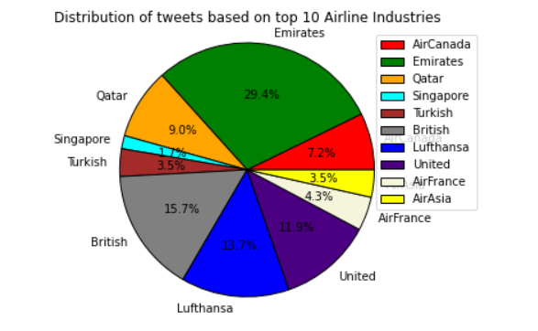
Research questions
Which Airline Industry has highest tweets from 2021 to 2022?
This question helps us to find the most preferable Airline which can be targeted by multiple passengers. They would have many queries regarding this industry.
Based on the distribution of tweets on top ten
Airlines, it can be observed the highest
percentage of tweets comes for Emirates Airline
Industry, that had 29.4% tweets during 2021 to
2022.

Slide 9

Text Preprocessing
The various text preprocessing steps are:
Punctuations
Tokenization
Stop words removal
Stemming
Lower casing
Emojis removal

Slide 10
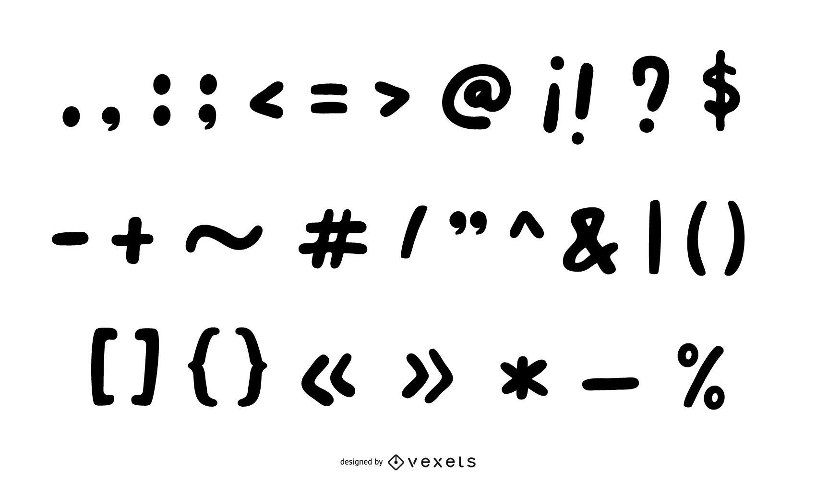
Punctuation Removal
Library (re): A regular expression (or RE) specifies a set of strings that matches it; the functions in this module let you check if a particular string matches a given regular expression (or if a given regular expression matches a particular string, which comes down to the same thing).
Lambda function: This function can have any number of arguments but only one expression, which is evaluated and returned.
I used regular expression: [a-zA-Z0-9] mean that any letter (regardless of case) or digit will match.

Slide 11
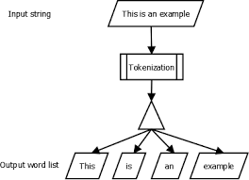
Tokenization
Tokenization: Tokenization is the process of replacing sensitive data with unique identification symbols that retain all the essential information about the data without compromising its security.
re.split() method split the string by the occurrences of the regex pattern, returning a list containing the resulting substrings.
\w: Matches any alphanumeric character; equivalent to [a-zA-Z0-9].

Slide 12
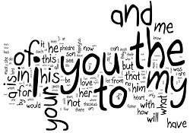
Stop Words
Stop words: Stop word removal is one of the most used preprocessing steps across different NLP applications. The idea is simply removing the words that occur commonly across all the documents in the corpus. Typically, articles and pronouns are generally classified as stop words.
remove_stopwords(): "remove_stopwords" which takes an argument " txt_tokenized" is shown. Because the txt_tokenized is a full text, it is needed to take every word uniquely by using nltk.corpus, which txt_tokenized data without punctuations.

Slide 13
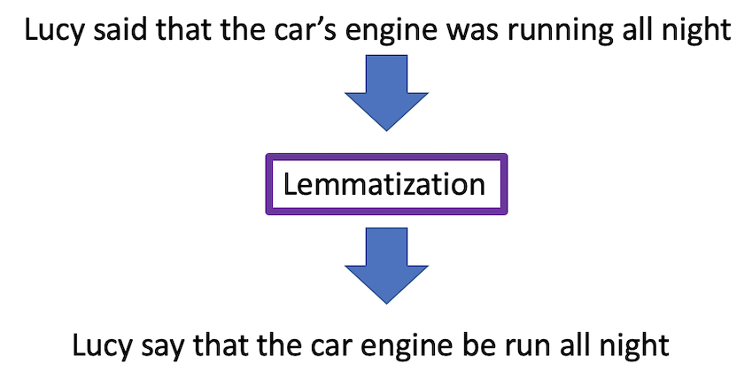
Lemmatization
Lemmatization is the process of grouping together the different inflected forms of a word so they can be analyzed as a single item. In contrast to stemming Lemmatization is more powerful because it removes inflectional endings only and to return the base or dictionary form of a word, which is known as the lemma.
Example:
am, are, is be car, cars, car's, cars' car

Slide 14
Polarity
For calculating polarity of a text, polarity score of each word of the text, if present in the dictionary, is added to get an 'overall polarity score'. For example, if a lexicon matches a word marked as positive in the dictionary, then the total polarity score of the text is increased.
The min value is -0.895700, which indicates the polarity or intensity of the most negative response is strongly negative (range of sentiment polarity score is -1 to +1)
The max value is +0.988300, which indicates the polarity or intensity of the most positive response is highly positive (range of sentiment polarity score is -1 to +1)
The mean value is +0.594633 which indicates the average polarity or intensity of sentiment across all responses is in the positive territory.

Slide 15
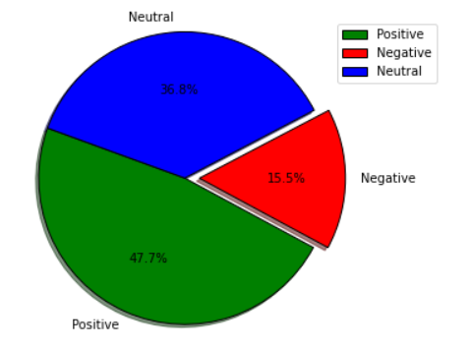
2. For one year period, what will be the public response about top ten airlines?
This question will help to determine the response of passengers that will give an idea about the top ten airlines. Either response can be positive, negative, or neutral.
According to the sentiments, there is 47.7 percent
Positive reviews regarding top ten airline industries.
Followed by Neutral tweets that got 36.8%. However,
There is least percentage of Negative tweets over the
period.

Slide 16
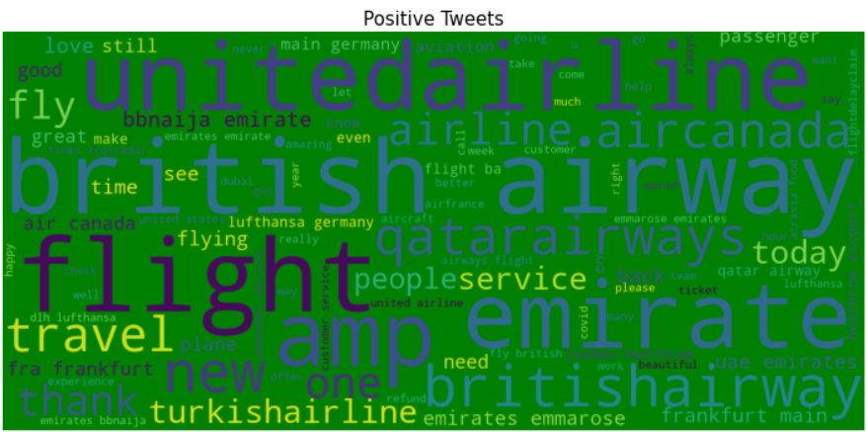
World Cloud of Positive Tweets
As it can be seen that most frequent words in positive world clouds such as love, good, great, better so on.

Slide 17
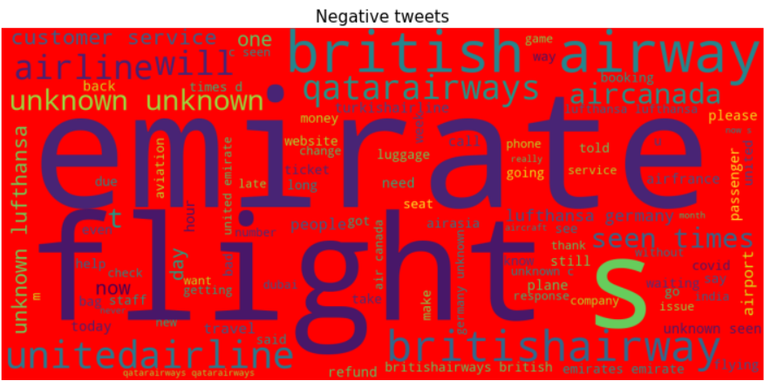
World Cloud of Negative Tweets
As it can be seen that most frequent words in Negative world clouds such as delay, back, refund, change etc.

Slide 18
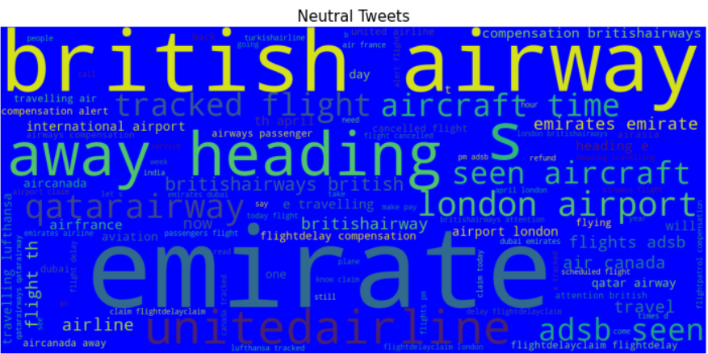
World Cloud of Neutral Tweets
As it can be seen that most frequent words in Neutral world clouds such as Delay, love, new, travel so on.

Slide 19
Feature Extraction using TF-IDF
TF-IDF acronym for Term Frequency & Inverse Document Frequency is a powerful feature engineering technique used to identify the important words or more precisely rare words in the text data.
Term Frequency - Inverse Document Frequency
TF = how frequently term occurs in a document
IDF = weight of rare words (The weight that word occurs rarely in the sentence have high IDF score)
How to calculate TF-IDF
TF(t) = (Number of lines term t appears in a document)/total number of terms in the document.
IDF(t) = log (total number of documents)/Number of documents with term t in it.

Slide 20
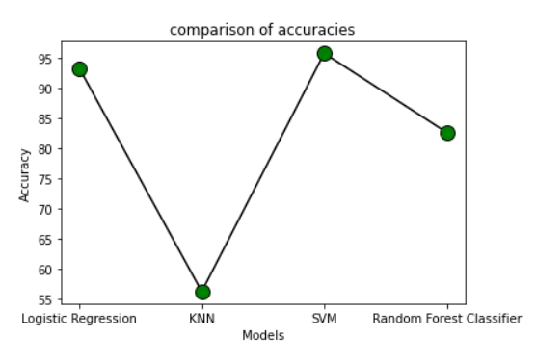
3. Predict and compare the accuracy of sentiments using different machine leaning models.
Series | Model | Accuracy
1 | Logistic Regression | 93.21
2 | KNN (K-nearest neighbour) | 56.25
3 | SVM (Support Vector Machine) | 95.70
4 | Random Forest Classifier | 82.60

Slide 21
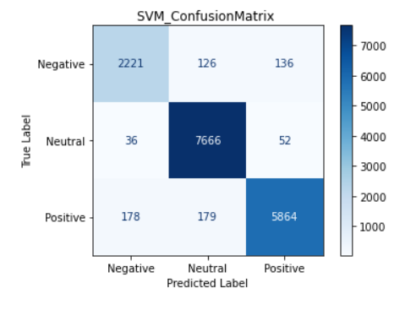
Confusion Matrix of Support Vector Machine
Confusion matrix depicts that actual and predicted value for positive tweets is 5864, neutral tweets is 7666 and negative tweets is 2221. So, the result of confusion matrix in the favor of Neutral tweets.

Slide 22
Conclusion
This study conducted by using twitter sentiments on the bases of top ten Airlines that has overall positive response. As Emirates airline industry gained more popularity by getting highest tweets over the period between 2021 and 2022. As well as learning algorithms, Logistic Regression, KNN, SVC and Random Forest Classifier on Sentimental analysis. Overall, SVM reached at 95% accuracy, it means Support Vector Machine is the best fit model for this project.

Slide 23
Thank You

